Slide 1

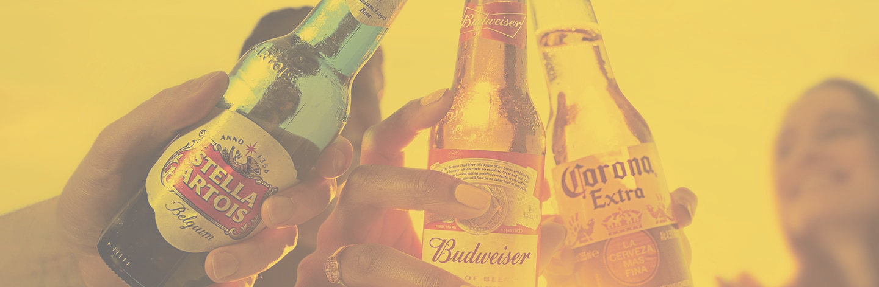
MARKET SEGMENTATION

Slide 2
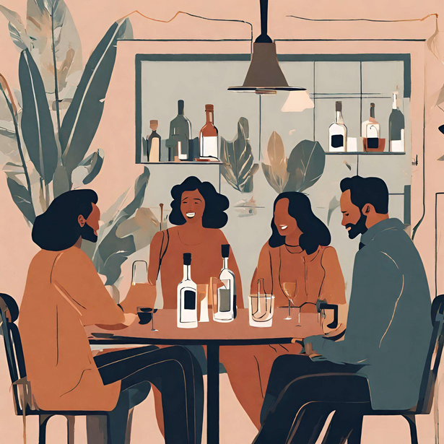
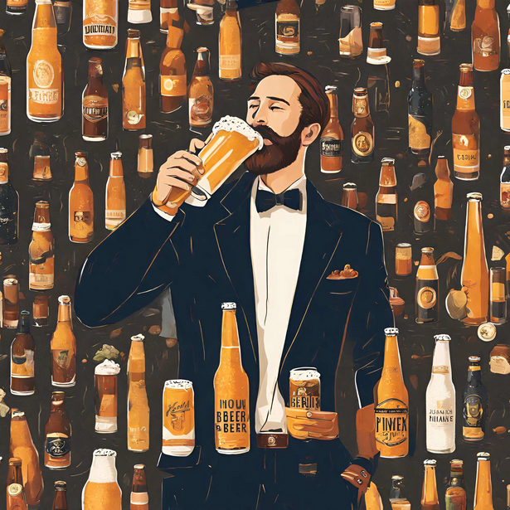
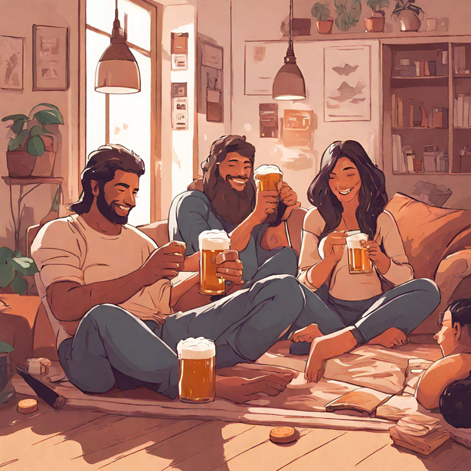
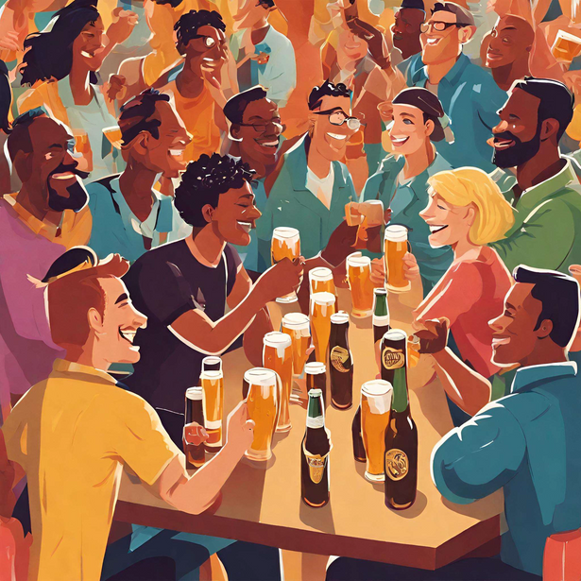
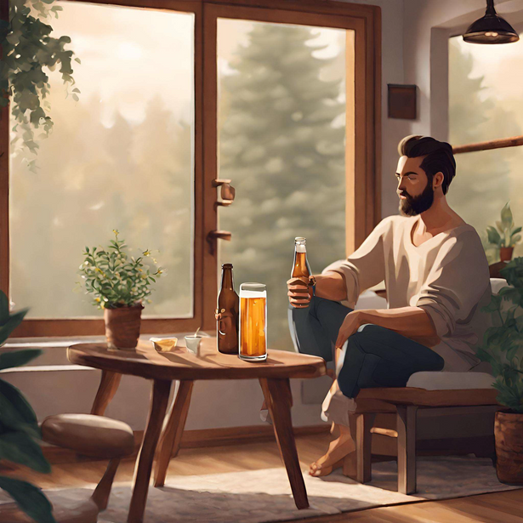
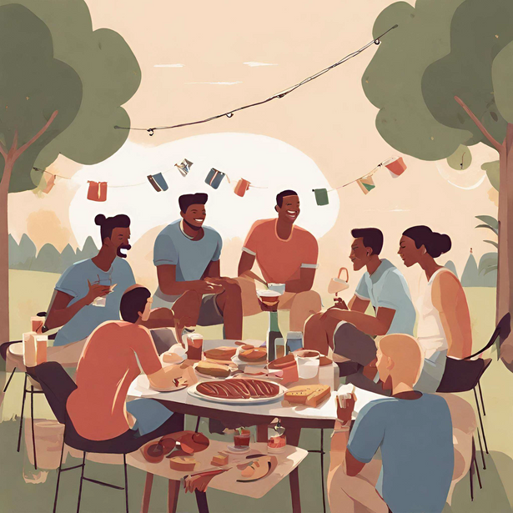
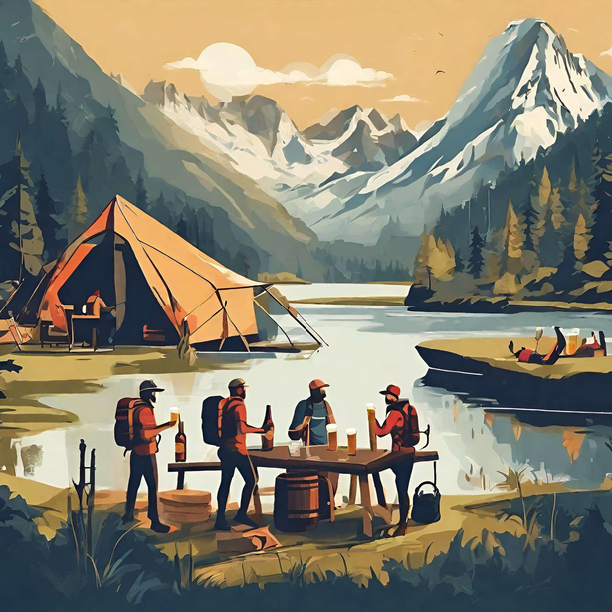
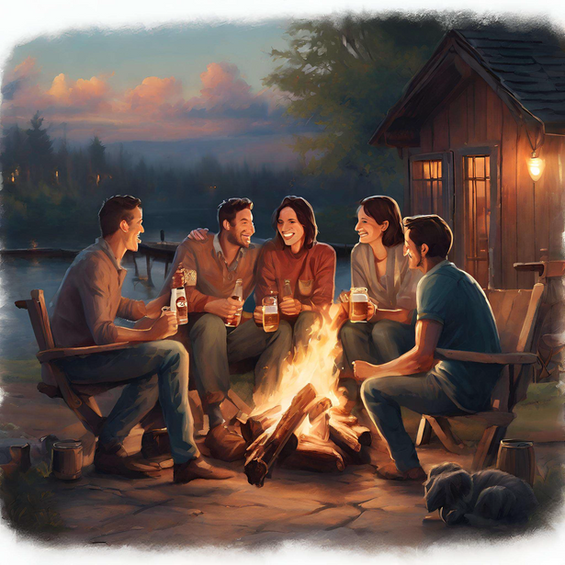
Executive Summary: Findings
Harmony Quaffs
Quality Connoisseurs
Relaxed Connectors
Social Sippers
Refined Sippers
Discerning Shoppers
Casual Browsers
Dynamic Aficionados
Serenity Sippers
Ready-to-Drink Relaxers
Adventurous Qualitarians
Beer Connoisseurs
Thoughtful Homebody
Effortless Indulgers
Heritage Voyagers
ChillBrew Crew

Slide 3




Executive Summary: The Process
GOAL
Use segmentation to optimize market spend, enhance customer satisfaction and brand loyalty, etc.
Group customers by shared characteristics
Identify 8 personas and “True Labels”
Create a reproducible model
Objective
EXPLORATORY DATA ANALYSIS
MODEL SELECTION AND VALIDATION
DASHBOARD
Census data comparison
Data preprocessing:
Data reduction
Data cleaning
Data transformation
Model: Hierarchical
# of Clusters: 8
Feature Selection:
Top 50 important for each cluster
Data Accuracy:
Silhouette score of 0.5
Easier interpretation of results
Visualized:
Clusters
Feature Selection
Feature Distributions
Methodology
3

Slide 4
DASHBOARD

Slide 5
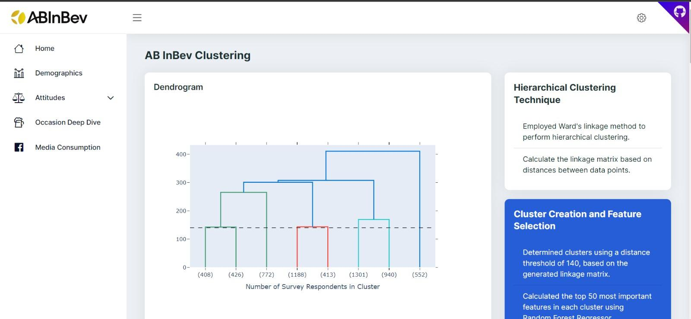
Flask App Solution
Homepage
5

Slide 6
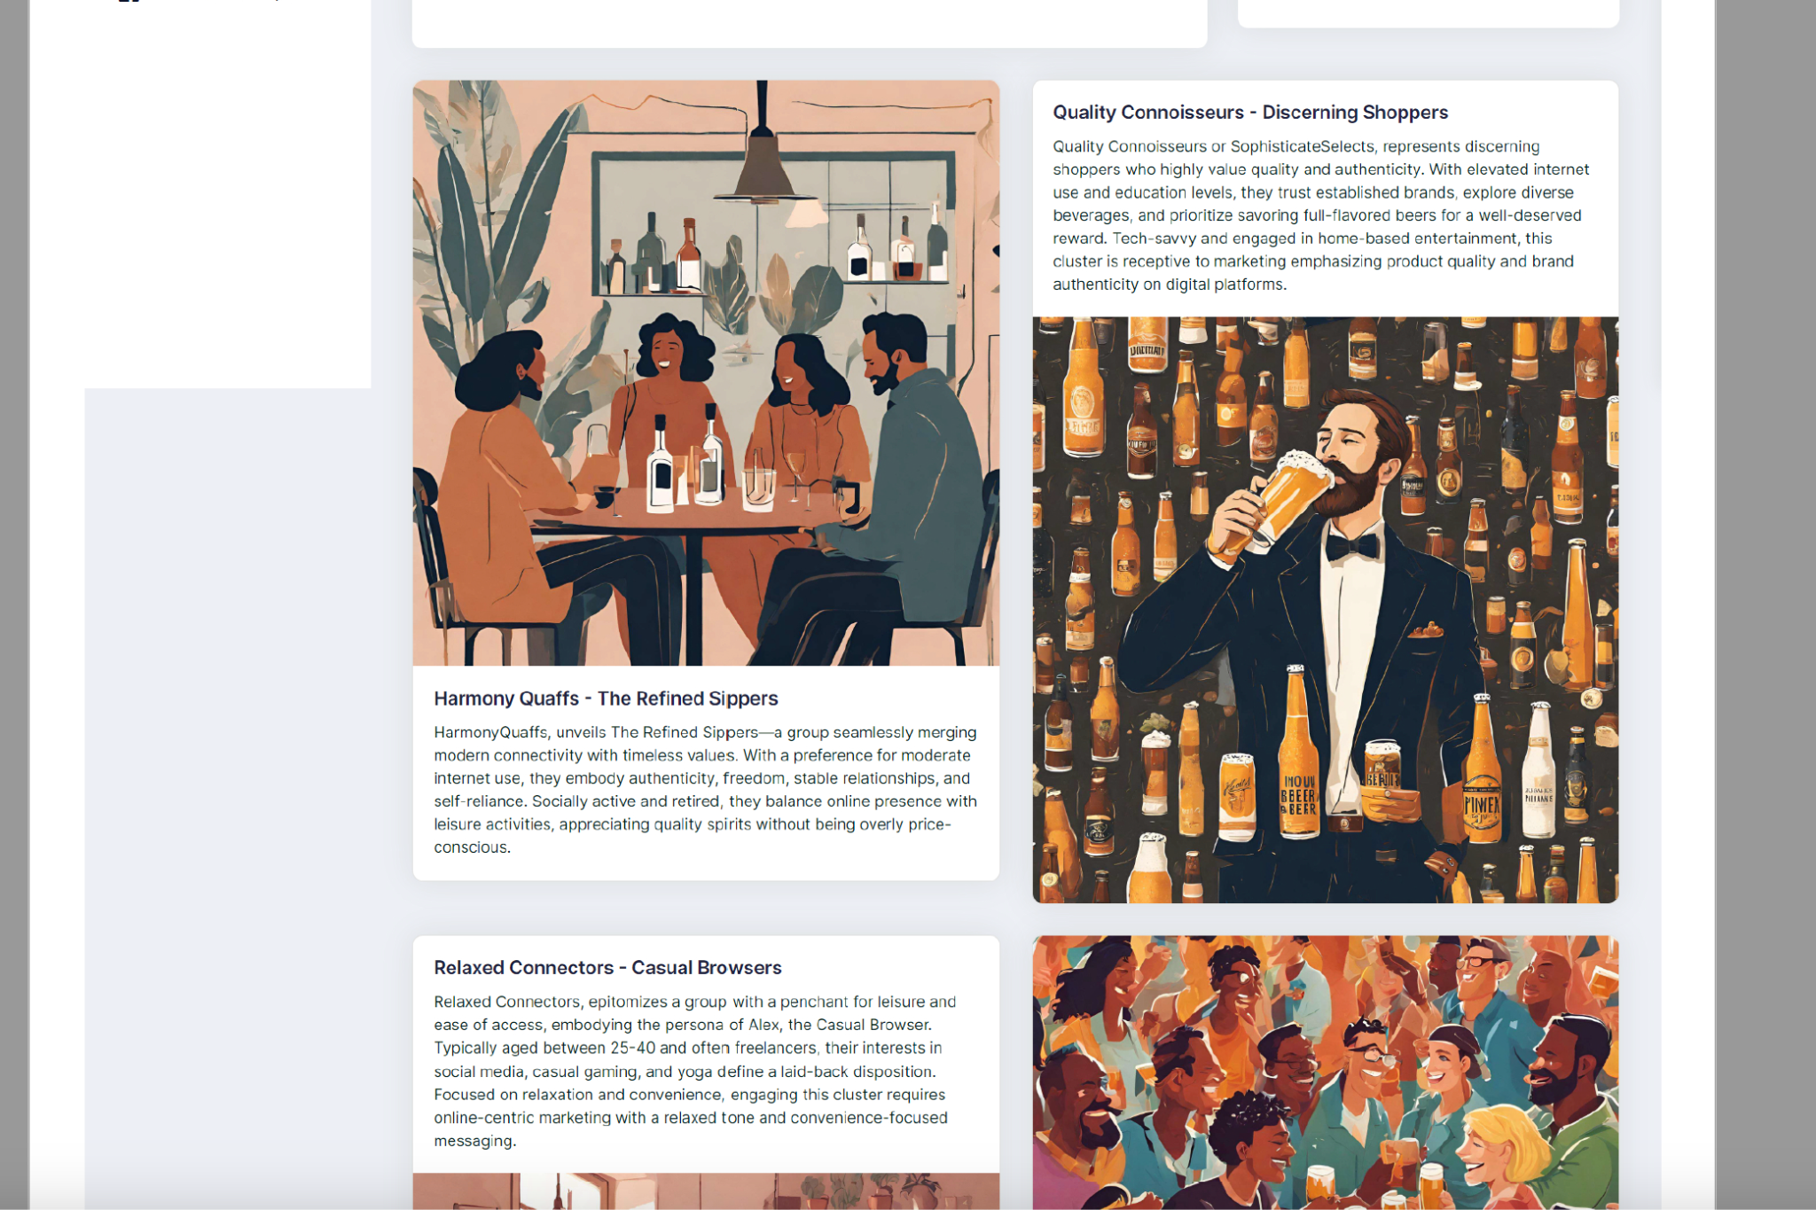
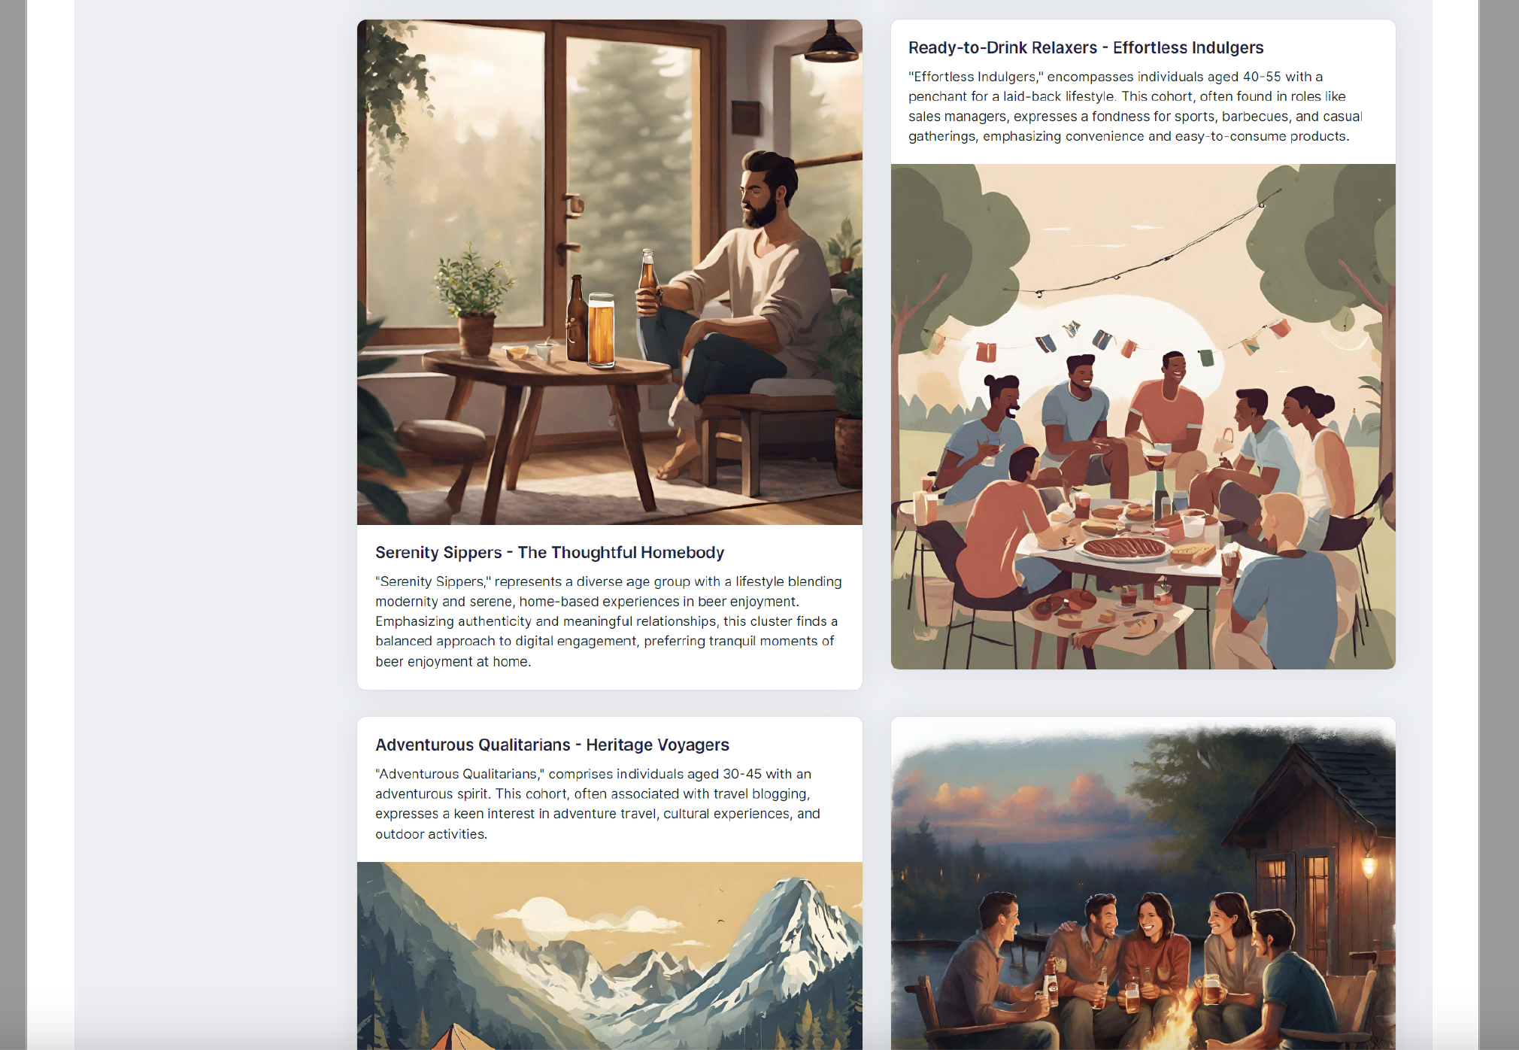
Flask App Solution
6

Slide 7
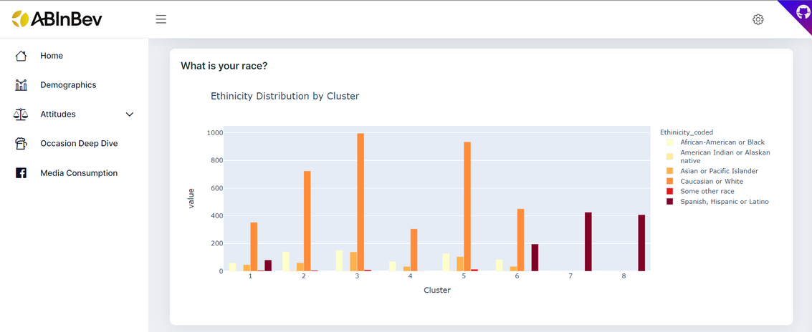
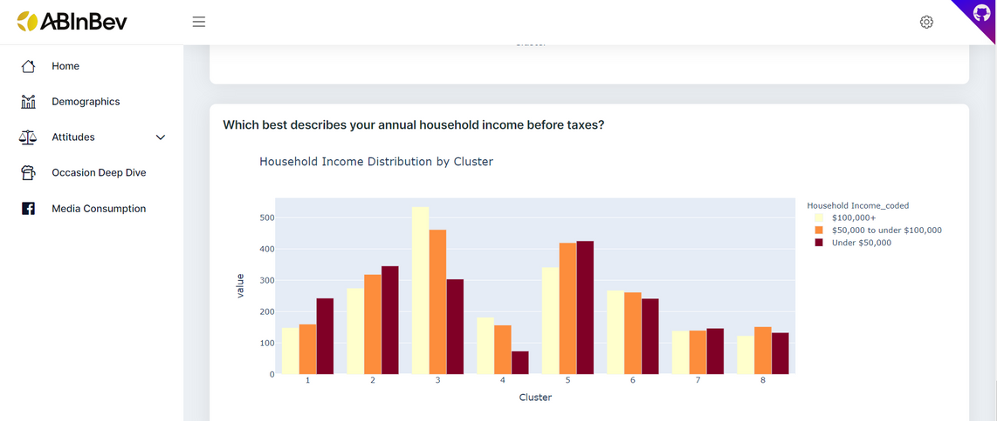
Flask App Solution
7

Slide 8
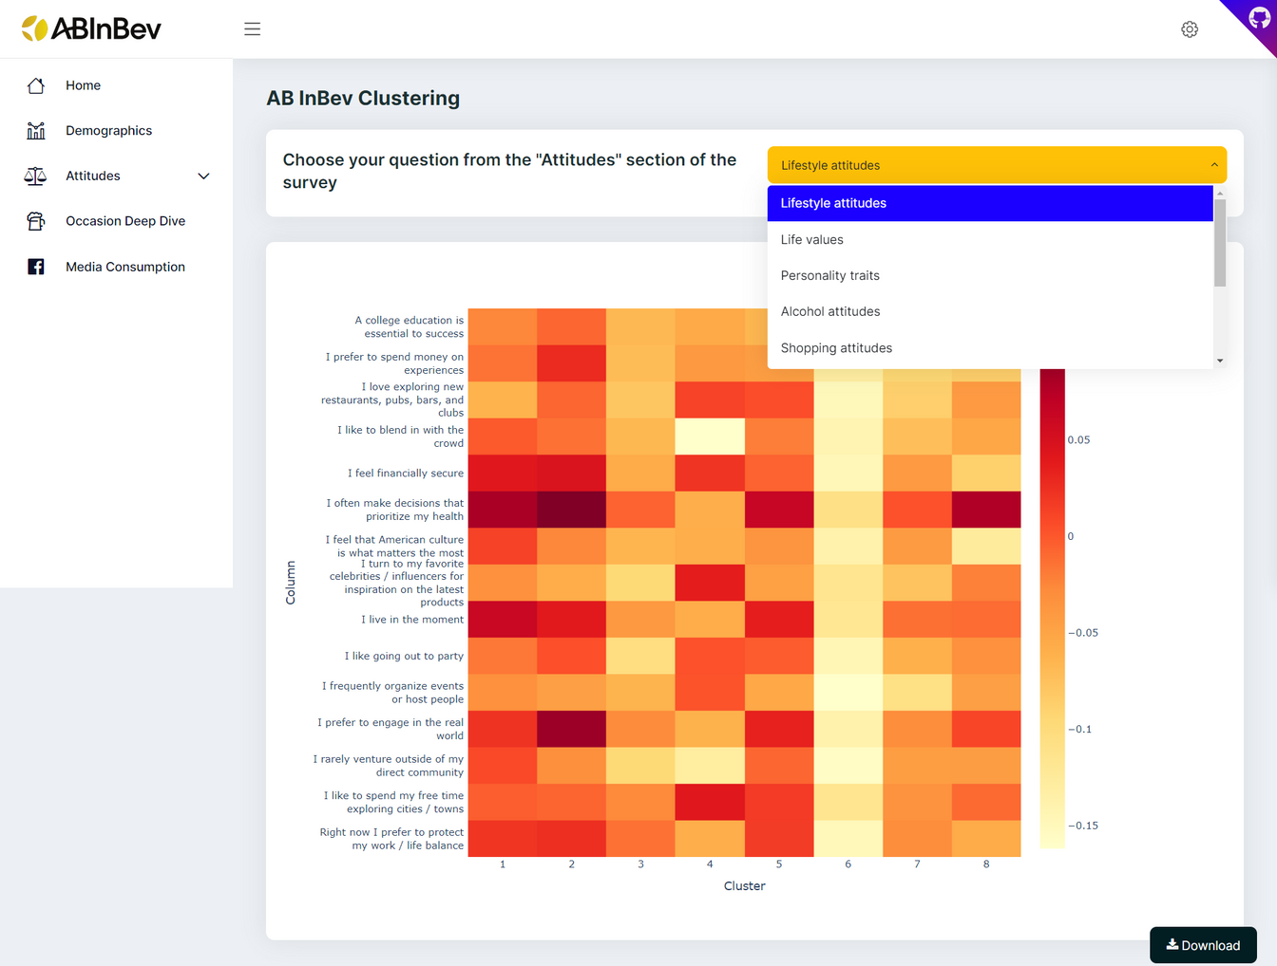
Flask App Solution
8

Slide 9
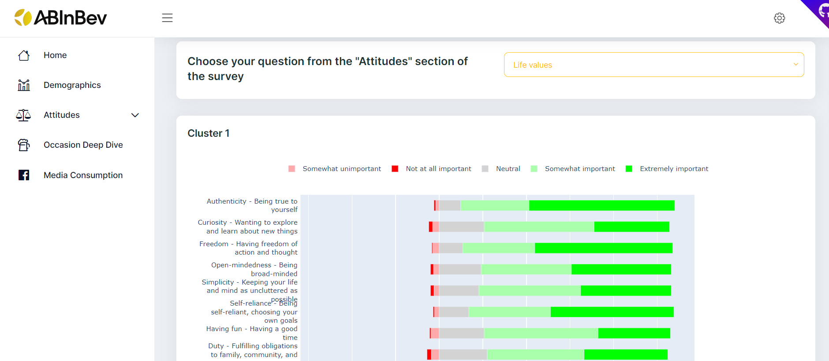
Flask App Solution
9

Slide 10
CENSUS DATA COMPARISON

Slide 11
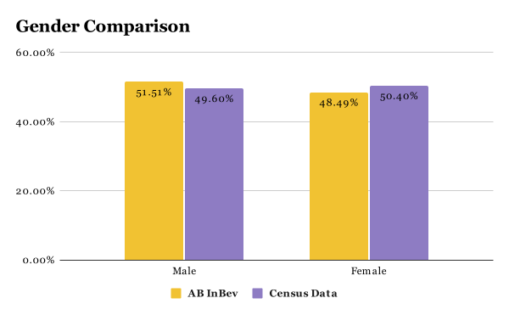
Census Data Comparison
Client Data
Census Data
Accurately representative across all groups
14

Slide 12
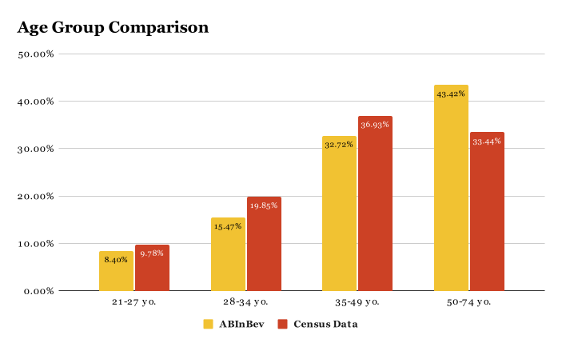
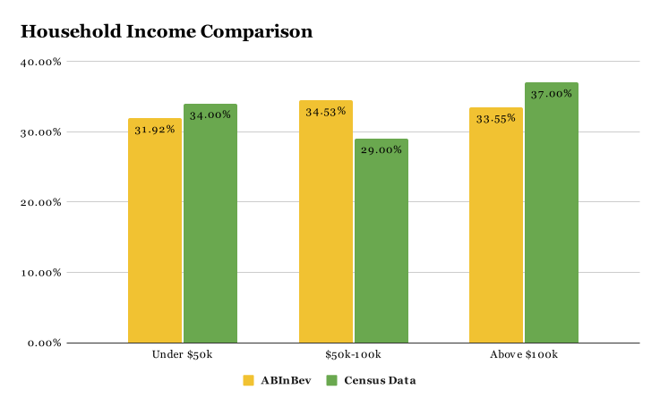
Census Data Comparison
Client Data
Census Data
Client Data
Census Data
15

Slide 13
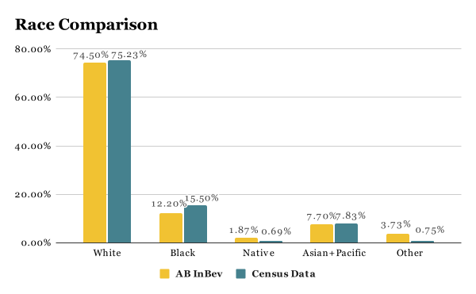
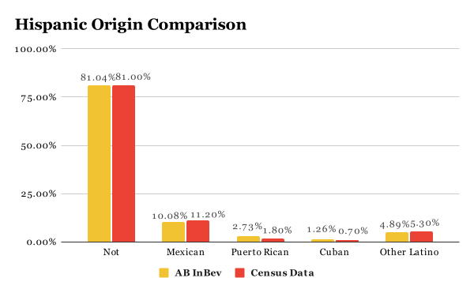
Census Data Comparison
Client Data
Census Data
Client Data
Census Data
Accurately representative across all groups
16

Slide 14
PREPROCESSING

Slide 15
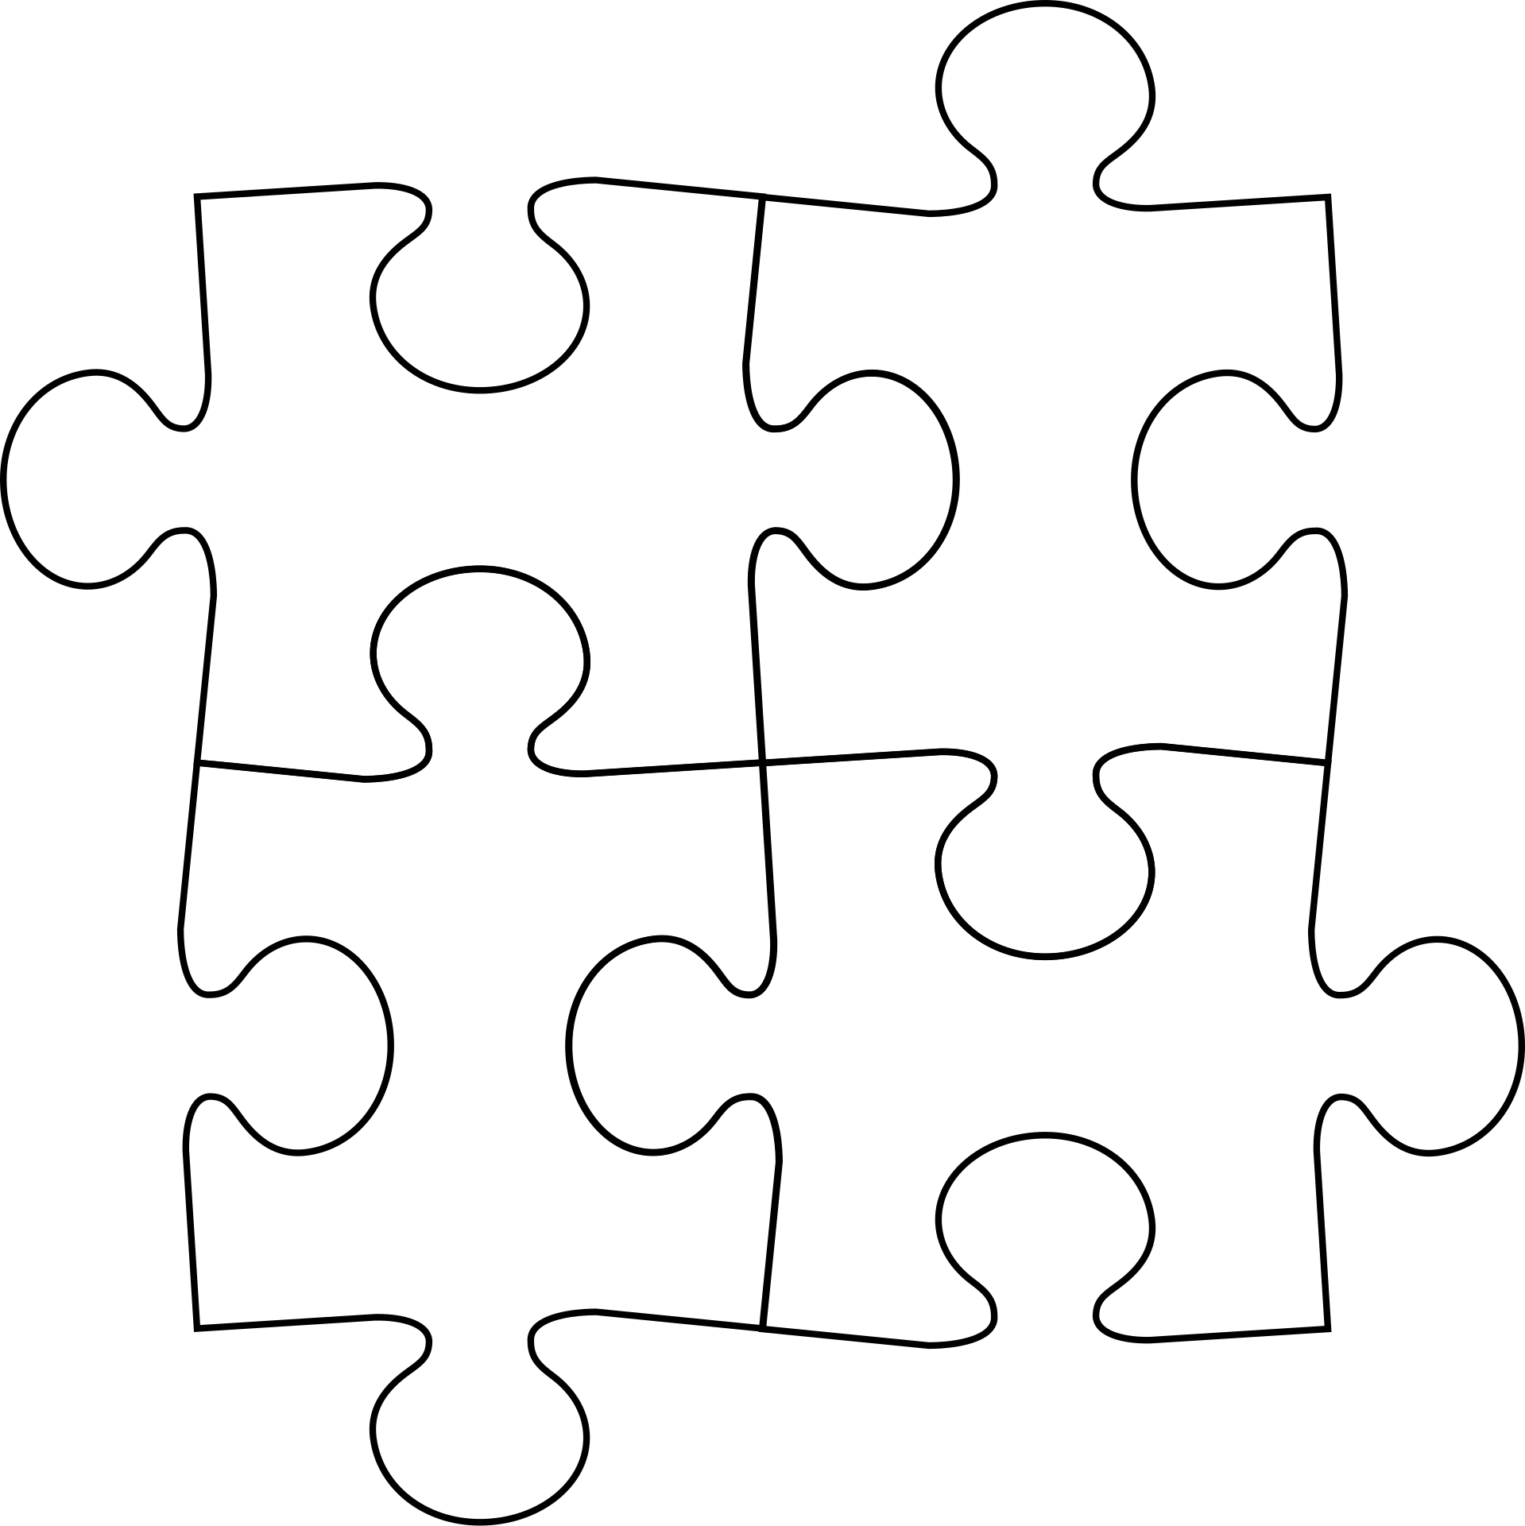



Steps Taken
Missing Values
Scaling
Handled missing values
Imputed with -1.
Scaled the entire dataset
Used MinMaxScaler with the range (-1,1)
Data Reduction
Regularisation & Order
Removed metadata columns
Removed ~40 columns not in the survey questions
Reversed Likert scale and order
Made the scale consistent
18
Notes:
Column Dropping
Removed metadata columns like ‘Respondent_Serial’ and ‘yyyymmdd’, and about 40 columns in the end which are not in the survey questions.
Reversing Likert and Order
Q. A1 & A3 had associated columns: 'A1Order' and 'A3Order', which determines if the survey is in normal or reversed order. Changed the order to a consistent scale and removed the Order columns

Slide 16
MODELING

Slide 17
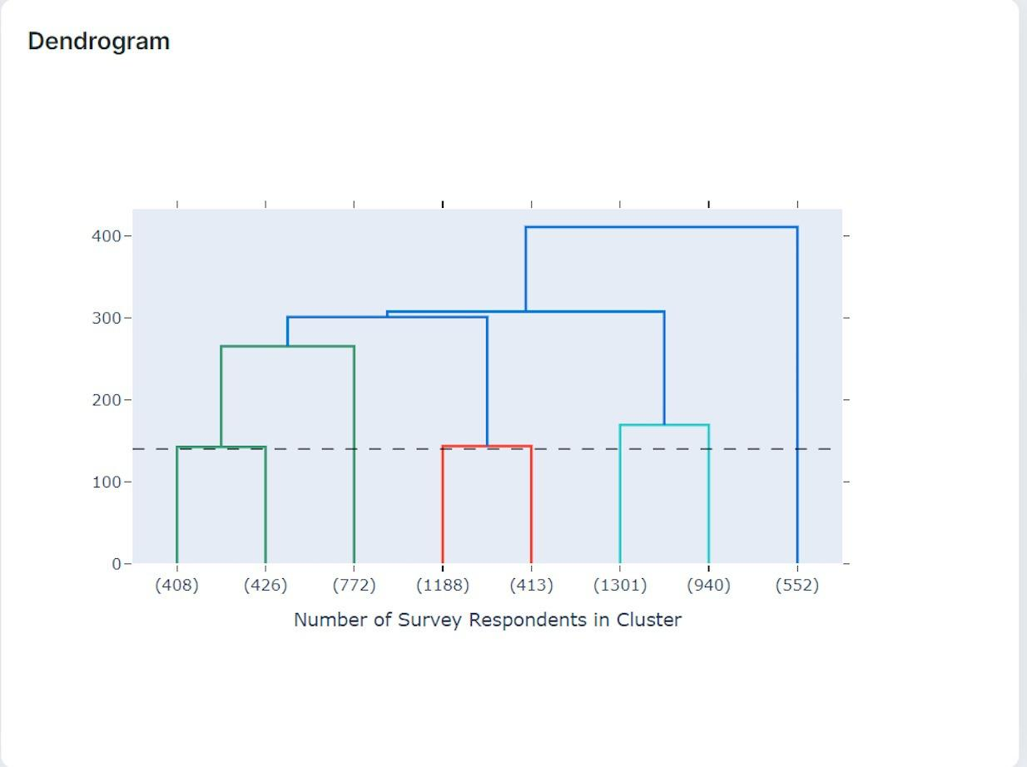
Clustering Technique
Dendrogram
Hierarchical Clustering
Created linkage matrix using Ward method and Euclidean distance
20

Slide 18
FEATURE SELECTION

Slide 19
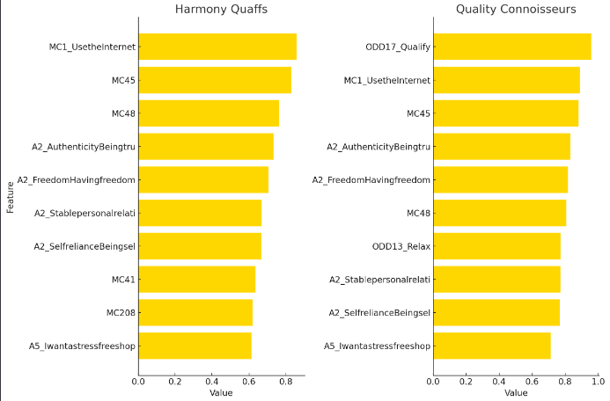
Feature Importance
Process:
1. Used RandomForestClassifier on top 50 features for importance.
2. Analyzed feature impact by cluster.
Cluster 1 - "Harmony Quaff":
Prefers stable relationships; less internet engagement; Refined taste in choice of beverage.
Cluster 2 - "Quality Connoisseurs":
Values quality and authenticity; responsive to quality-focused marketing.
22

Slide 20
SUCCESS CRITERIA

Slide 21


Performance Metrics
Technical Aspect
Business Aspect
Hierarchical Clustering
Comprehensive Data Preprocessing
Cluster Homogeneity and Validation:
Used Silhouette Score
Aim for value to be close to 1.
Improved from 0.1 to 0.5.
Expected to improve with more data.
Tailored Marketing Strategies:
Findings that can directly be translated into business strategies
Recommendations based on the specific characteristics of each cluster
Aim to align with marketing objectives, such as, but not limited to:
optimizing spend
improve customer satisfaction
enhance customer loyalty
24

Slide 22
ADDRESSING BUSINESS CHALLENGES

Slide 23
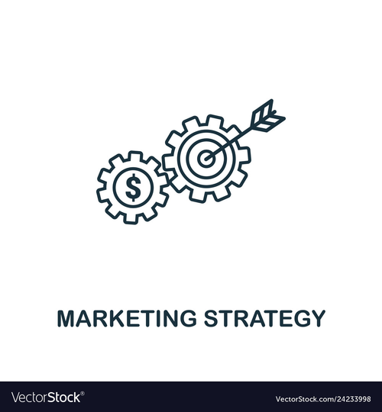
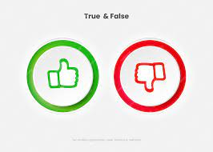
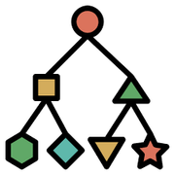
Addressing Business Challenges
Marketing Strategy for Diverse Customers
Classifying New Survey Results
Understanding Customers
Analyzed survey data to gain insights
Tailoring Marketing Strategies:
Identified 8 segments
Characteristics, Preferences, and Attitudes - Persona
Model Development
Feature Selection
Real-time Classification
Creating “True” Labels for Each Segment
Well-defined segments
Key Characteristics
Verification - Marketing POV
26

Slide 24
RECOMMENDATIONS

Slide 25
Recommendations
Harmony Quaffs
Quality Connoisseurs
Foster community and user-generated content.
Target retirees via lifestyle magazines and online forums.
Emphasize quality and authenticity on digital platforms.
Educated on beer varieties and food pairings.
Position beer as a reward for a healthy lifestyle.
28

Slide 26
Recommendations
Relaxed Connectors
Dynamic Aficionados
Use relaxed, casual tones in online advertising.
Focus on convenience in messaging.
Boost presence in social media and gaming, tie in wellness.
Introduce varied beer types and limited editions.
Partner with craft breweries for exclusive releases.
Host beer-tasting events and forums for community building.
29

Slide 27
Recommendations
Serenity Sippers
Ready-to-Drink Relaxers
Highlight beer's role in relaxation and stress relief.
Target moderate digital users via email and search marketing.
.
Showcase convenience of RTD products.
Align with social activities like sports and barbecues.
Market as perfect for relaxed gatherings.
30

Slide 28
Recommendations
Adventurous Qualitarians
Beer Connoisseurs
Use authentic storytelling and offline engagement.
Emphasize cultural pride and individuality.
Focus on travel, relaxation, and authenticity in marketing.
Provide educational content on beer brewing.
Organize exclusive beer-tasting events.
Leverage traditional media and event partnerships.
31

Slide 29
POTENTIAL CHALLENGES

Slide 30

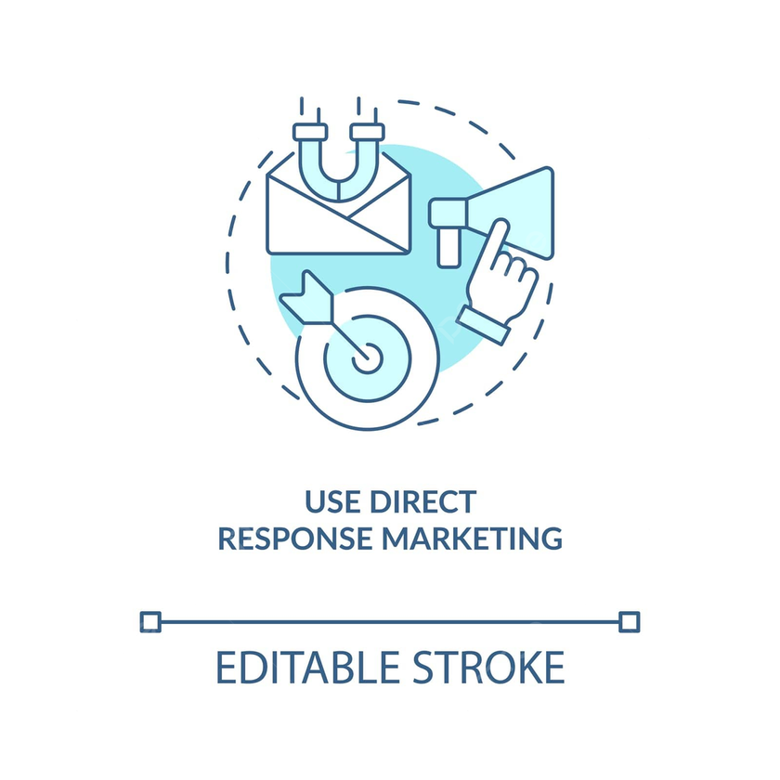

Potential Challenges
IMPLEMENTATION COSTS
MARKET RESPONSE
COMPETITORS
Customer-centric, Pro-active Approach
33
Notes:
After the successful adoption of segmentation modeling and the creation of cluster personas, AB InBev stands at the forefront of strategic marketing and consumer targeting. However, the journey ahead may pose some potential challenges. Firstly, implementation costs could become a significant factor, as the integration of sophisticated modeling techniques and persona clusters may demand financial resources. Careful financial planning and resource allocation will be crucial to navigate this hurdle effectively. Secondly, market response is very unpredictable, and despite advanced segmentation, consumer behavior may not always align with projections. Adapting quickly to dynamic market shifts and continuously refining strategies based on real-time feedback will be essential. Lastly, the competitive landscape remains dynamic, with rivals constantly evolving their approaches. AB InBev must stay vigilant, continuously innovate, and differentiate its offerings to maintain a competitive edge in the ever-changing market. Successfully overcoming these challenges will solidify AB InBev's position as an industry leader in leveraging segmentation and persona strategies.

Slide 31
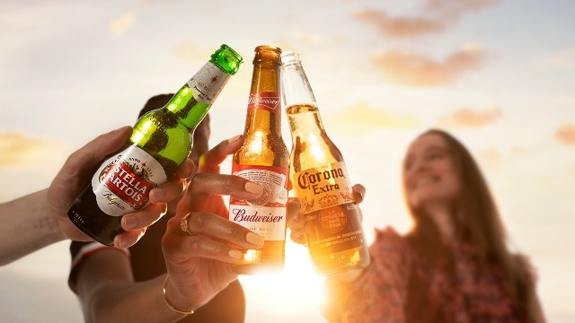
Thank You!
Notes:
Thank you, Chris and everyone else, for patiently listening to our presentation. We will be happy to take questions, if any.

